Slide 1
FALL DETECTION
GROUP-H2
GROUP LEADER:-M KUSHAGRA, Id:20191400074H
MEMBERS:-ASHUTOSH KHARE, Id:20191400077H
KUNAL MANNA, Id:20191400076H
RUSHA MONDAL, Id:20191400072H
SHUBHAM TYAGI, Id:20191400558H

Slide 2
CONTENTS
Overview
ROS Service
AWS alert service
Activity Diagram
Signal & Timing Diagram
Data Cleaning
Visualization

Slide 3
OVERVIEW
Data from both the sensors(accelerometer and gyroscope) is collected .
The data is then converted into magnitude and stored in a text file.
According to the sensor data, we decide the threshold and categorise the fall.
After categorising, we alert the concerned person via SNS and SES services provided by the Amazon Web Services.

Slide 4
SCENARIO FOR FALL
According to the sensor data, we decide the threshold and categorise the fall.
There are three categories for fall: Front, Backward, Lateral(left, right).
For example, if the accelerometer data values lie between 0.9 and 0.97 and gyroscope data values lie between 1.1 and 7.4, we can say that front fall has occurred.
We then save the categorized data into a .csv file.

Slide 5
SCENARIO FOR DAILY ACTIVITIES
According to the sensor data, we decide the threshold and categorise whether the person is sitting or walking.
For example, if the accelerometer data values lie between 0.91 and 0.94 and gyroscope data values lie between 2.63 and 5.5, we can say that the person is walking.
We then save the categorized data into the .csv file.

Slide 6
BLOCK DIAGRAM
Accelerometer
Gyroscope
Data Cleaning
Data Cleaning
Classification
Visualisation
Alert System

Slide 7
PACKAGE – FALL_DETECTION
NODES
accelerometer
gyroscope
Processing
Classification of falls
Visualization

Slide 8
Topics -
read_a
read_g
threshold
classify
decision
Message –
aX,aY,aZ(coordinates)
gX,gY,gZ
magnitde_a
magnitude_g
fall_type

Slide 9
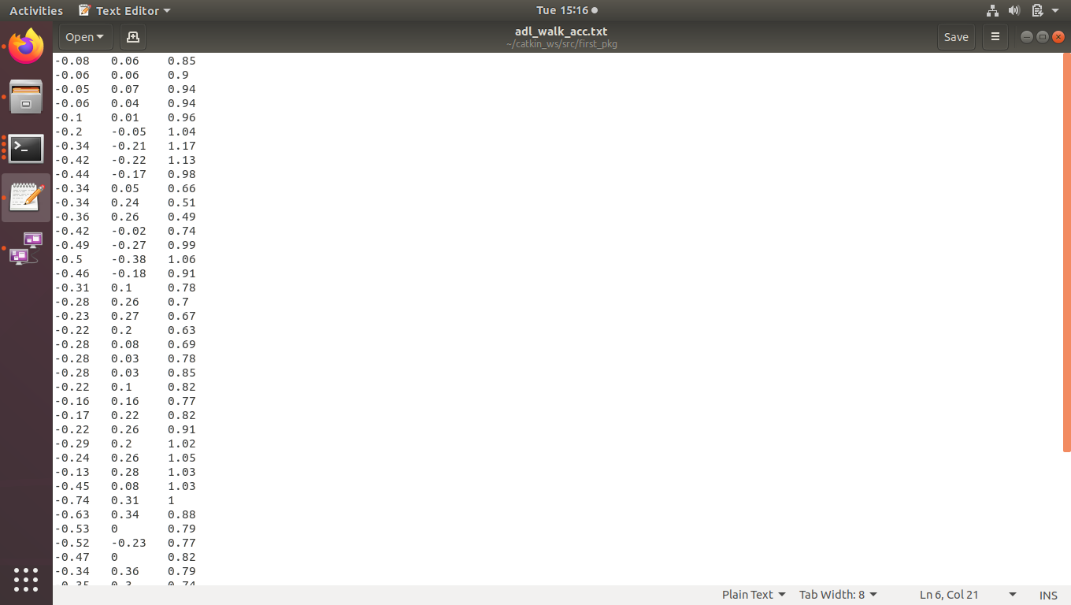
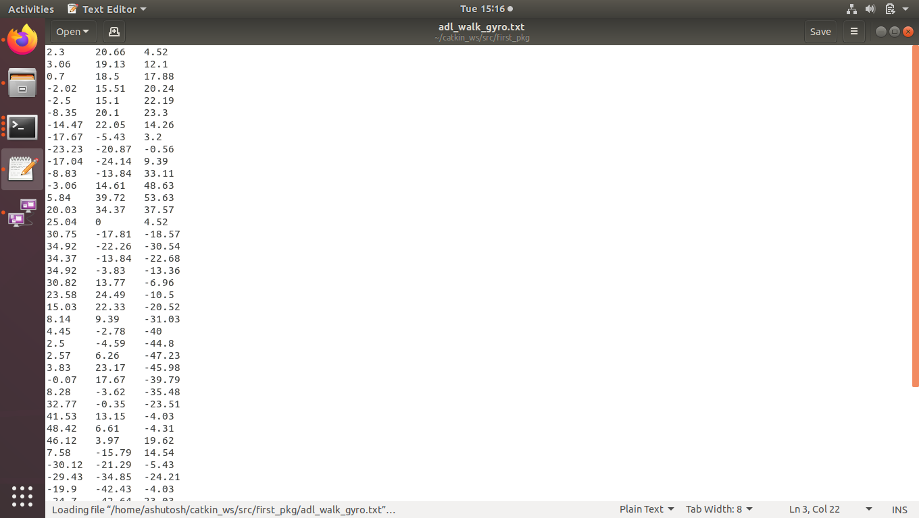
Input file(sensor axes)

Slide 10
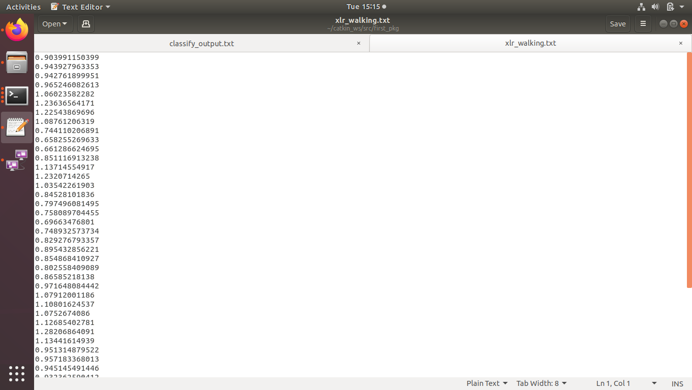
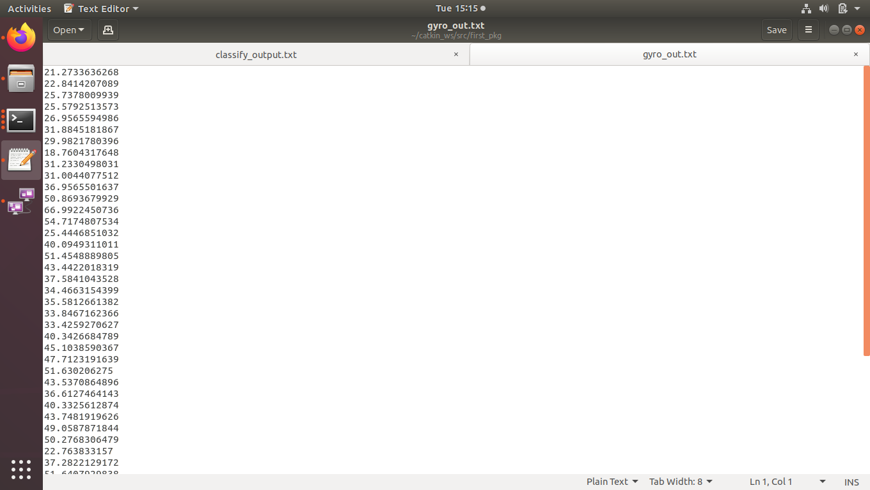
Processing Node
Accelerometer Input (mag) Gyroscope Input(mag)

Slide 11
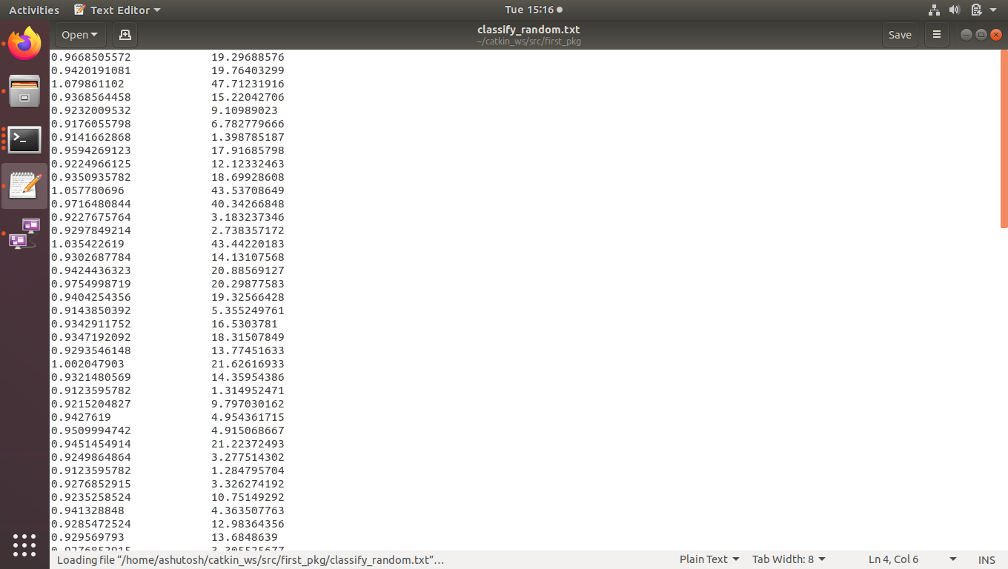
Accumulation of Data(Processing node)

Slide 12
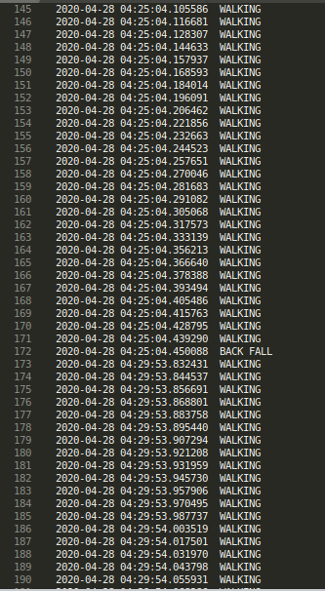
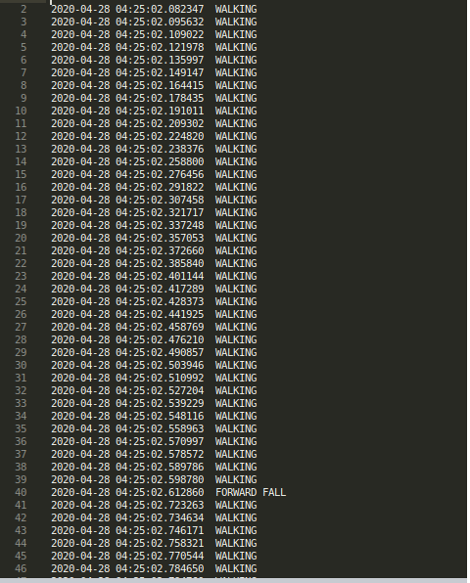
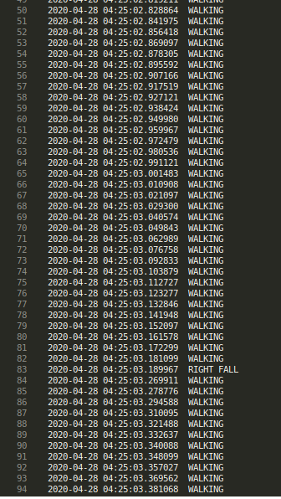
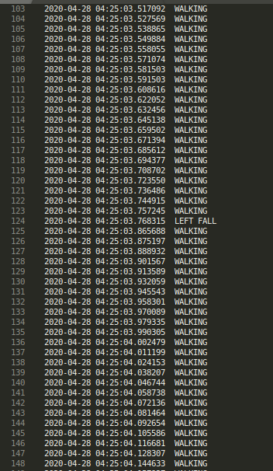
DECISION NODE OUTPUT

Slide 13
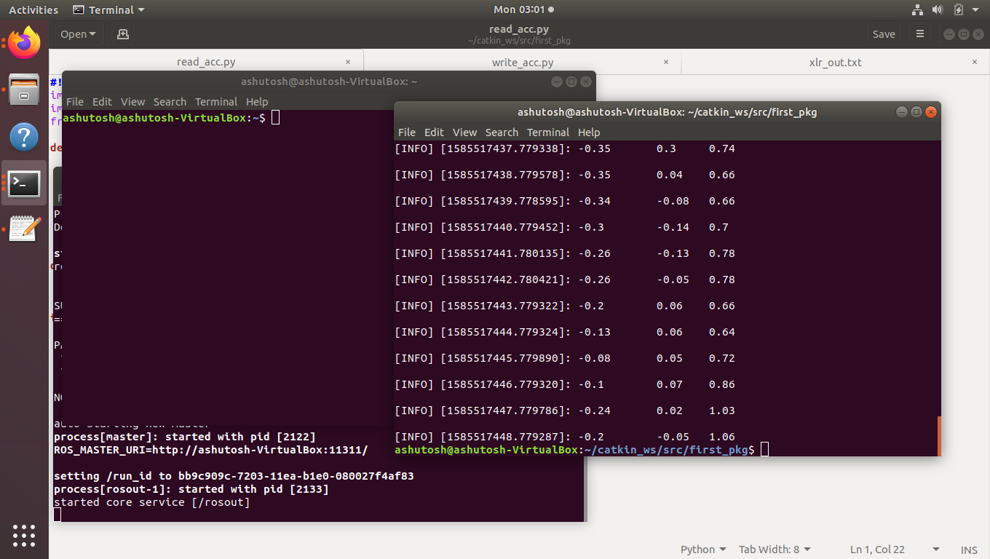
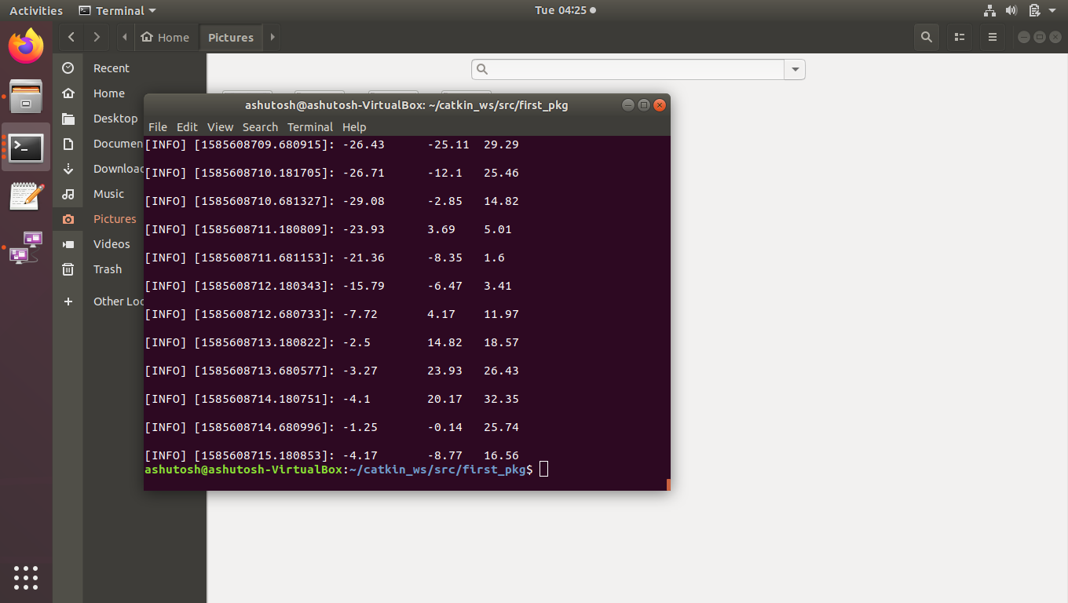


Slide 14
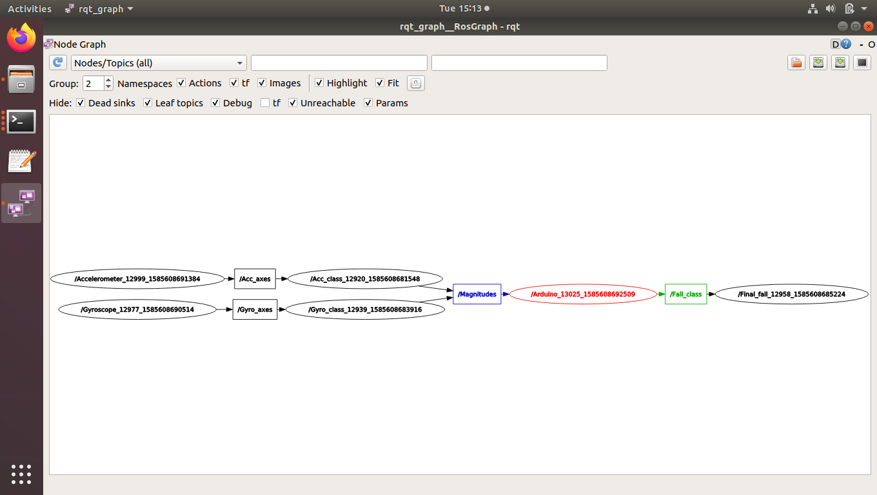
RQT Graph

Slide 15
ALERT SYSTEM THROUGH AWS
Amazon web services(AWS) is used for the alert system.
The alert is sent to the concerned person through SMS and mail.
We use Amazon Simple notification services(SNS) and Simple email services(SES).
If the system detects different types of falls, it sends the notification to the concerned person.

Slide 16
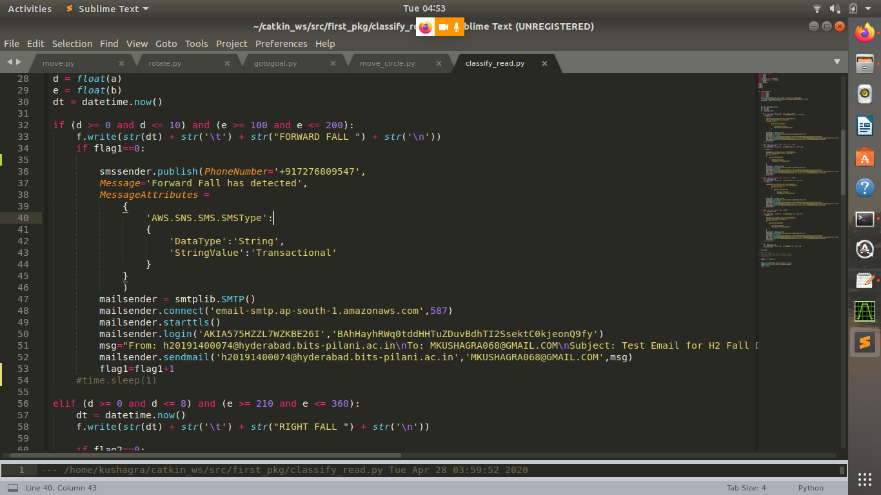
Implementation

Slide 17
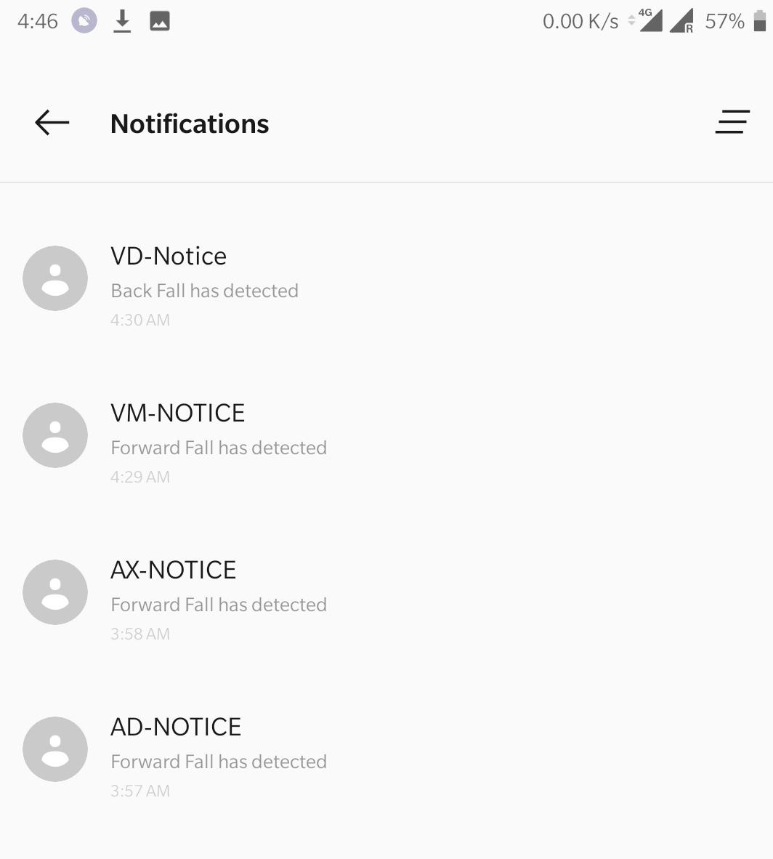
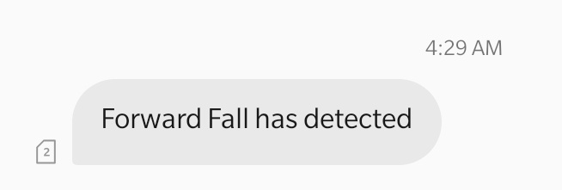
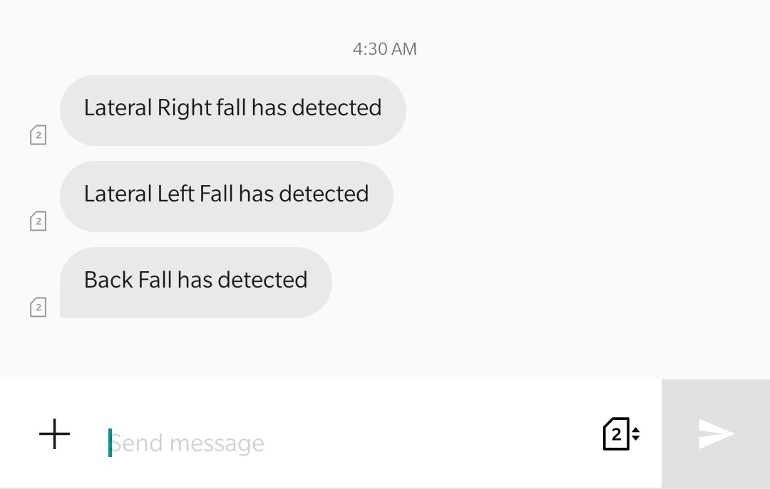
SMS RECEIVED

Slide 18
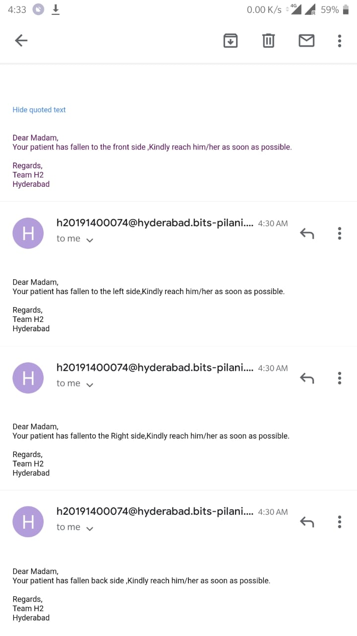
EMAIL RECEIVED

Slide 19
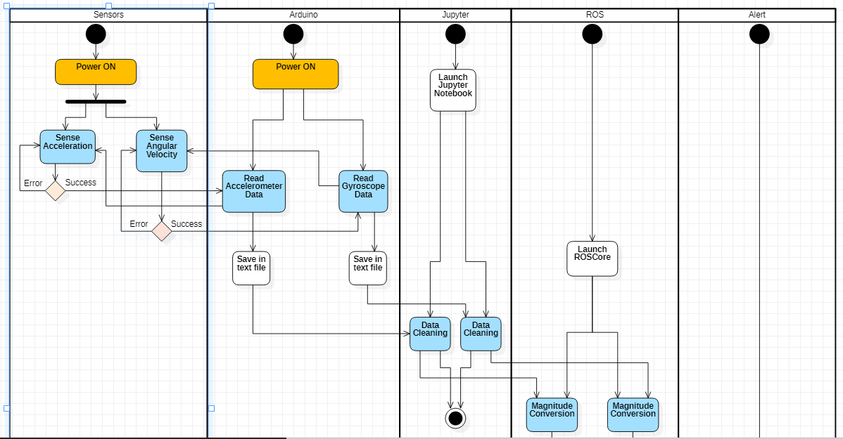
Activity Diagram
Every 1 sec
Every 1 sec

Slide 20
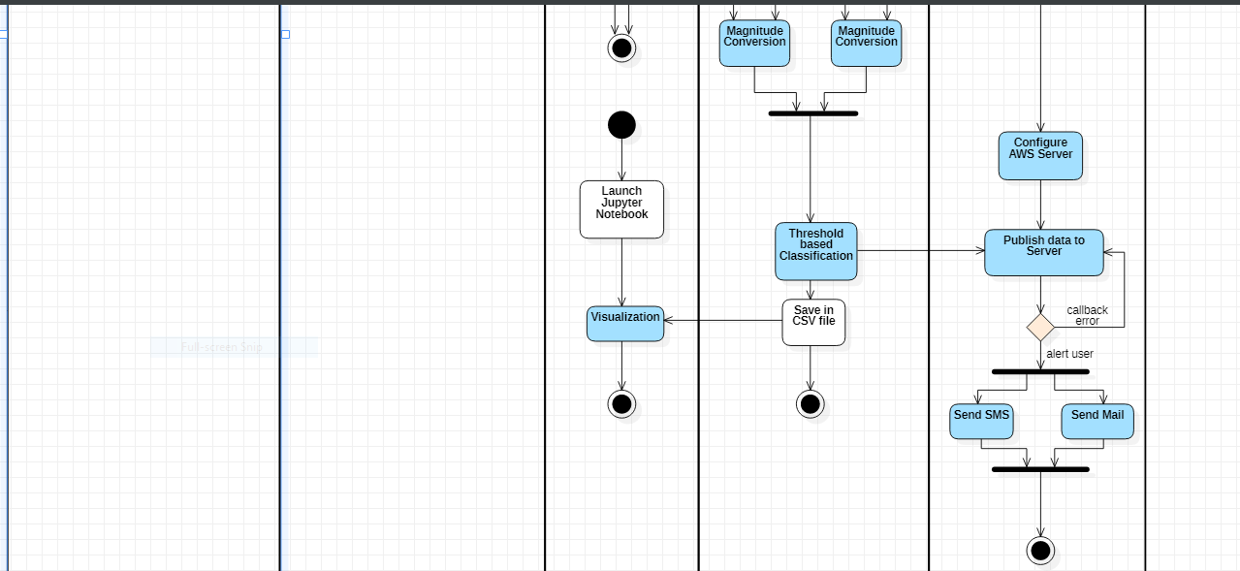

Slide 21
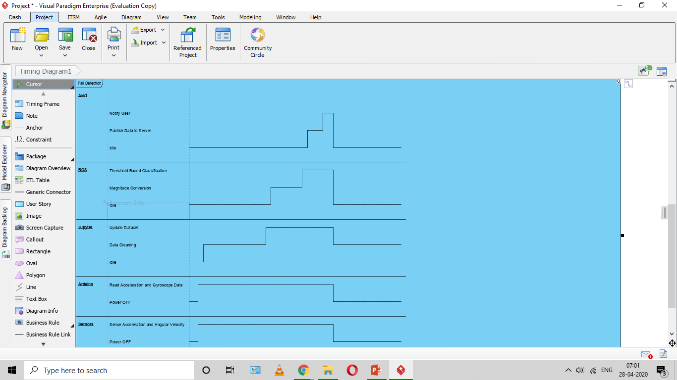
TIMING DIAGRAM
0
200
T(sec)

Slide 22
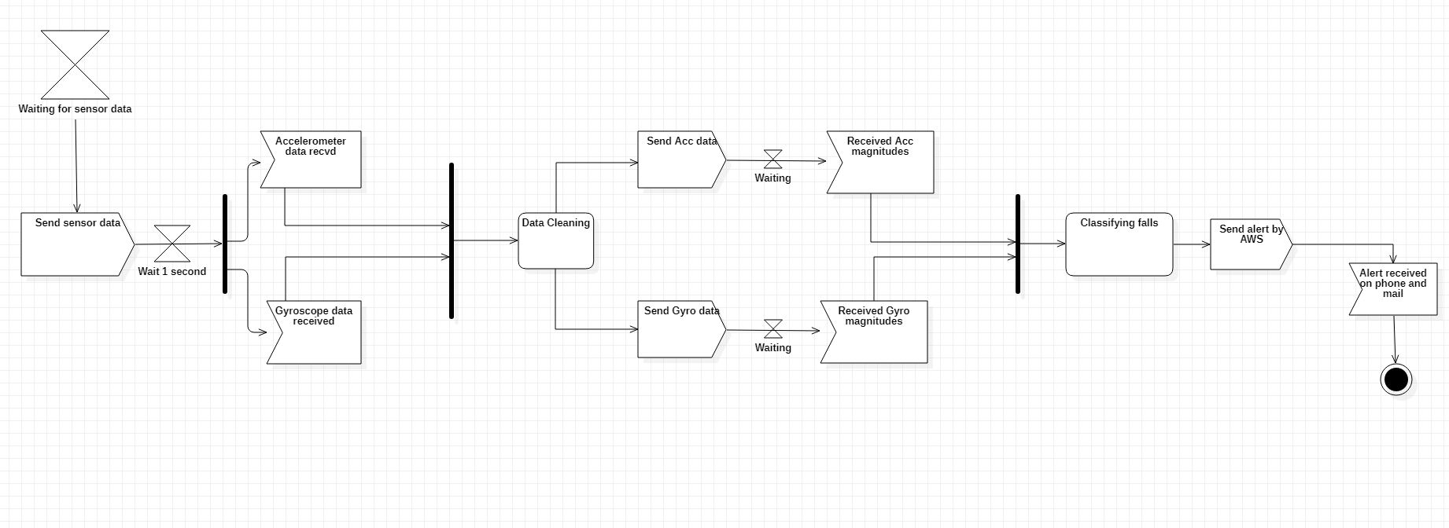
SIGNAL DIAGRAM

Slide 23
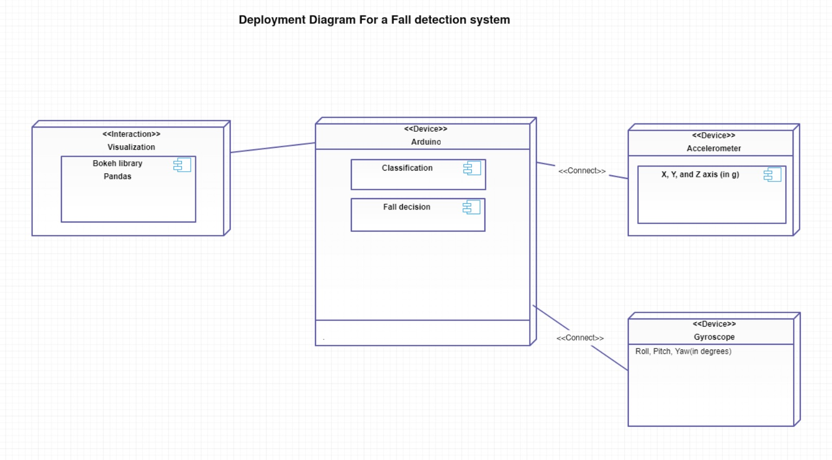

Slide 24
DATA CLEANING
When the data is recorded from the sensors , we may encounter invalid values which needs to be cleaned before sending it to the other nodes . So we need to perform data cleaning.
Data cleaning is performed on missing data present in a csv file and the cleaned data is updated to new csv file.

Slide 25
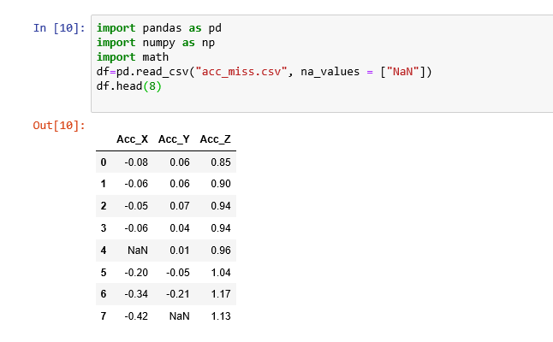
Missing Data from x, y, z axes of Accelerometer is first replaced with NaN.

Slide 26
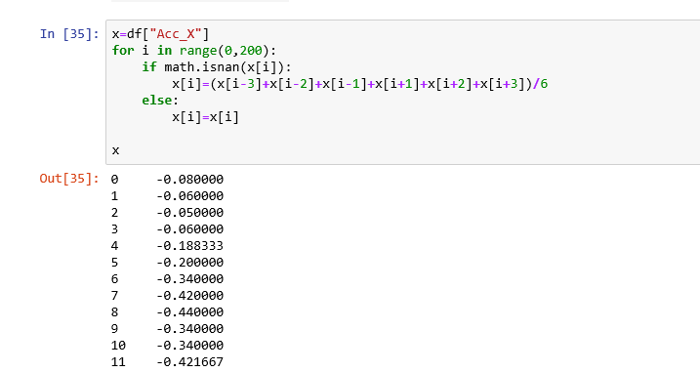
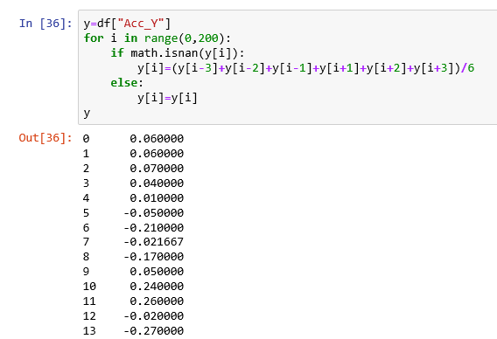
The missing data from each column is replaced with the mean of previous 3 and next 3 data.

Slide 27
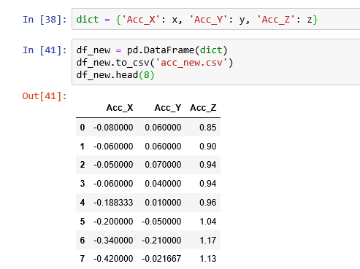
The cleaned data is updated in a new csv file .

Slide 28
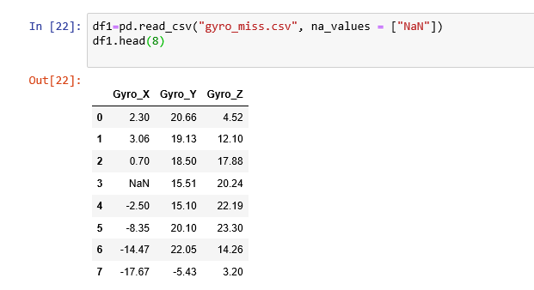
MISSING GYROSCOPE AXES DATA.

Slide 29
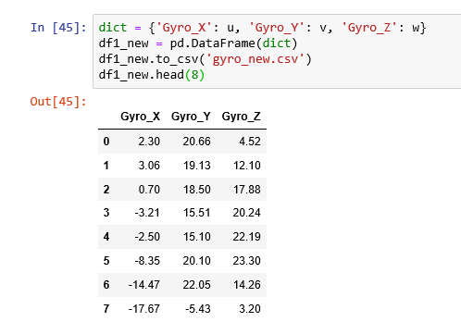
Similarly, the cleaned gyroscope axes data is updated in a new csv file .

Slide 30
VISUALIZATION
We used Bokeh , Plotly and missingno library for data visualization
We have used heatmap, bar graph, scatter plot and line chart
We have created both 2-D and 3-D plots.
These are the parameters that we have visualized:
Categorisation of falls based on Accelerometer and Gyroscope magnitude.
Frequency of falls.
Missing data in columns.
Accelerometer and gyroscope magnitudes with respect to time.

Slide 31
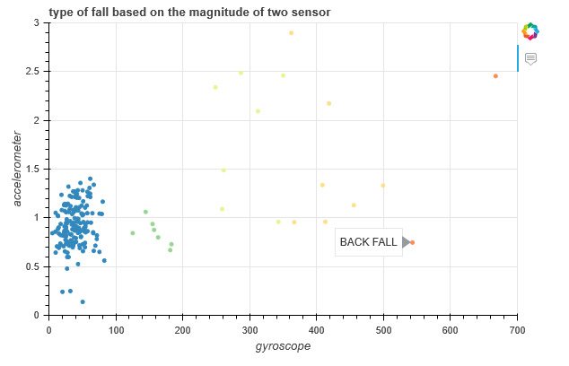
SCATTER PLOT(2D)

Slide 32
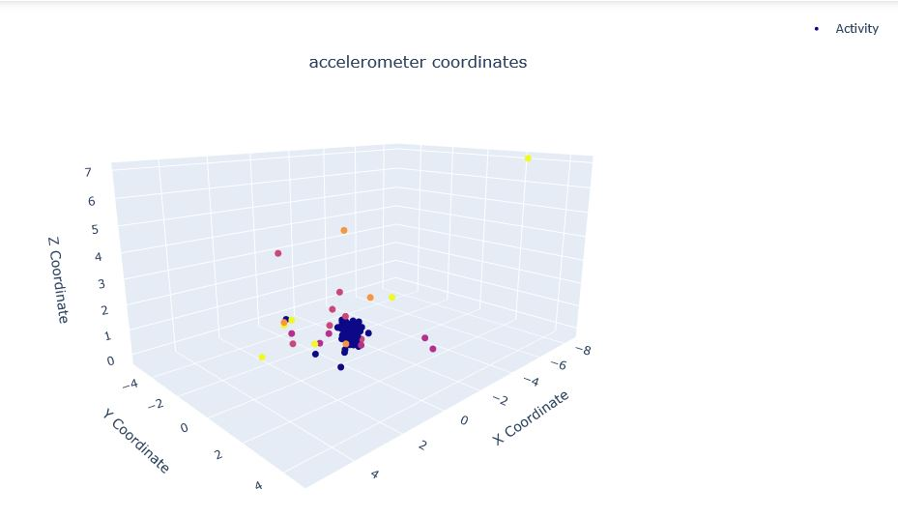
Scatter plot(3D)

Slide 33
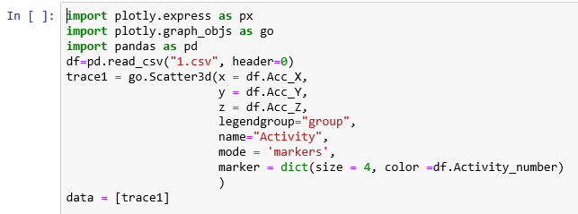
3D PLOT ACCELEROMETER COORDINATES PLOTLY CODE

Slide 34
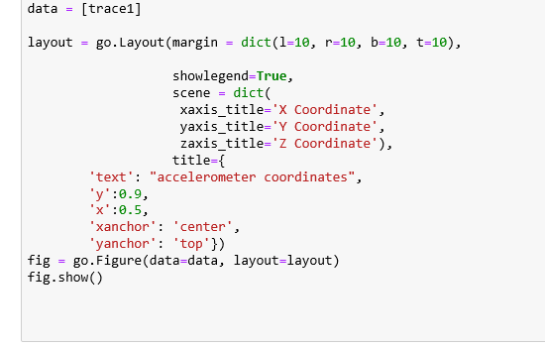
Cont.

Slide 35
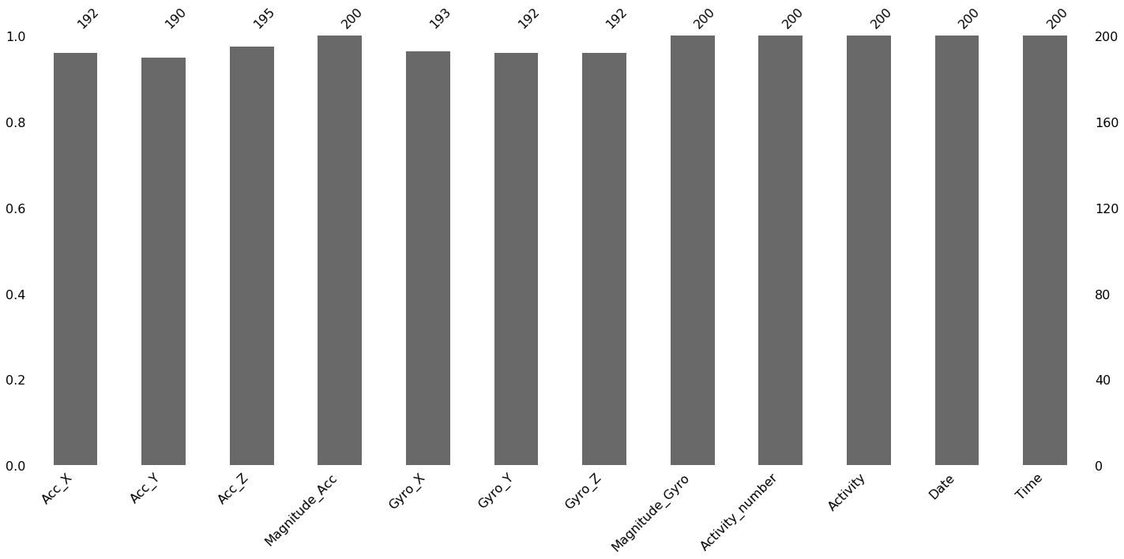
BAR CHART FOR MISSING NUMBERS

Slide 36
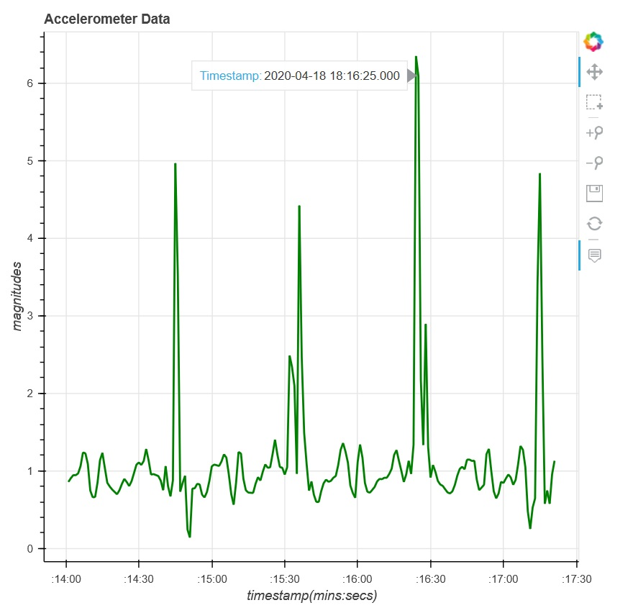
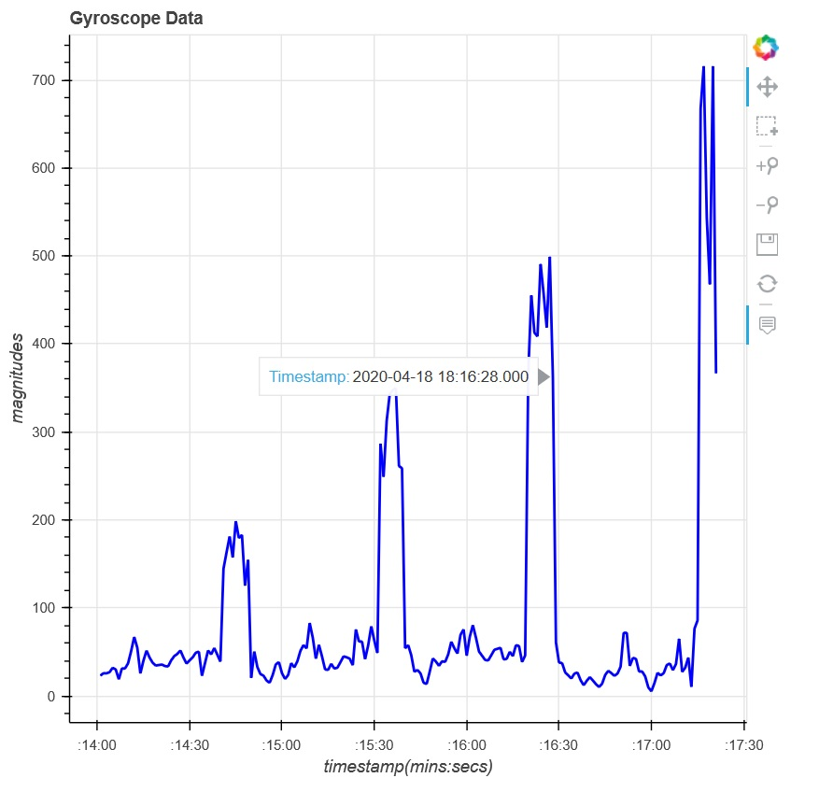
LINE PLOT

Slide 37
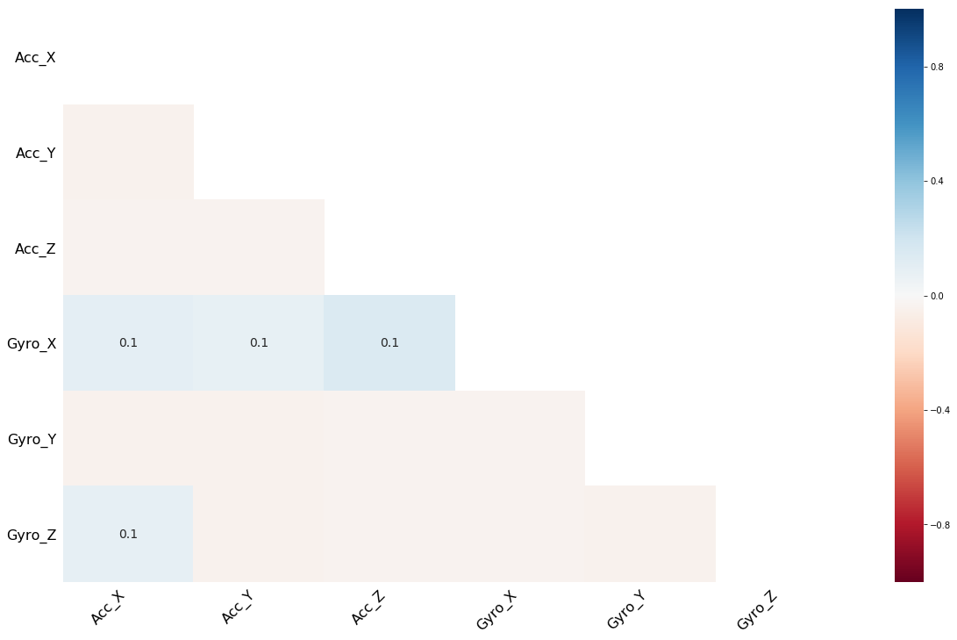
HEAT MAP(MISSING DATA)

Slide 38
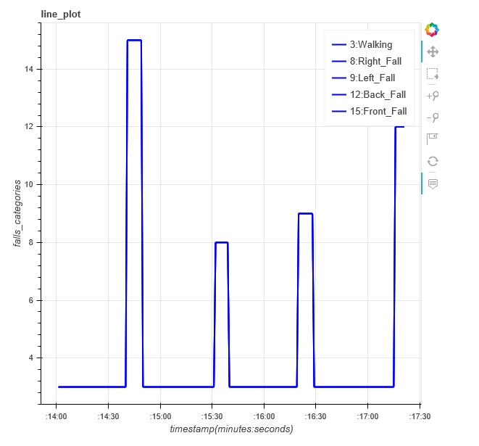
SINGLE LINE PLOT

Slide 39
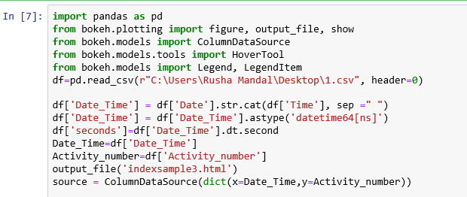
2D PLOT SINGLE LINE BOKEH CODE

Slide 40
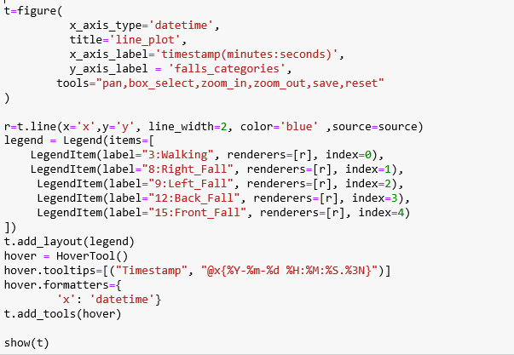

Slide 41
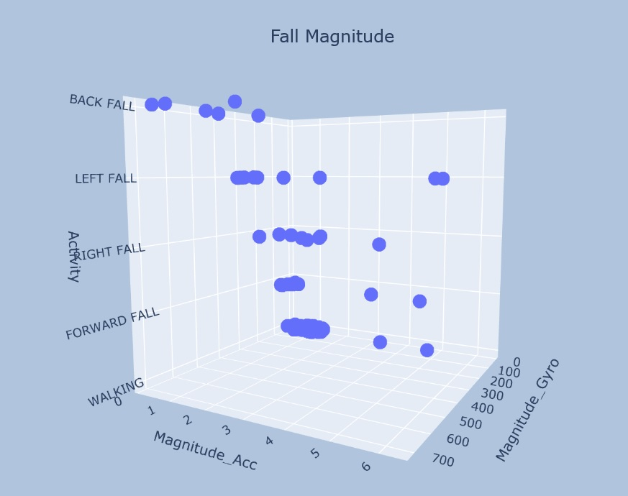
3-D PLOT

Slide 42
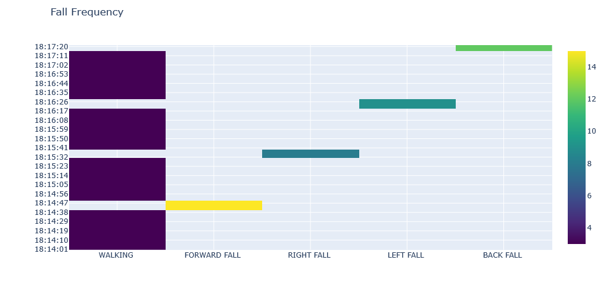
HEAT MAP(FALL FREQUENCY)

Slide 43
THANK YOU

